Slide 1
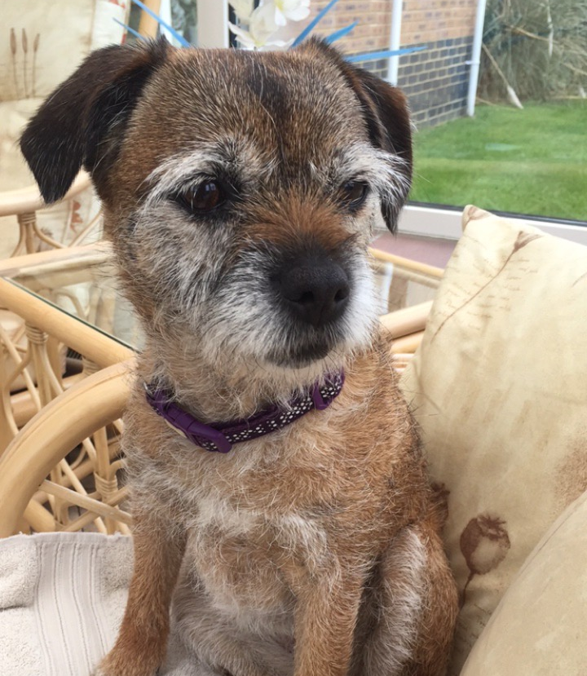
A week in the life of Roxy

Slide 2
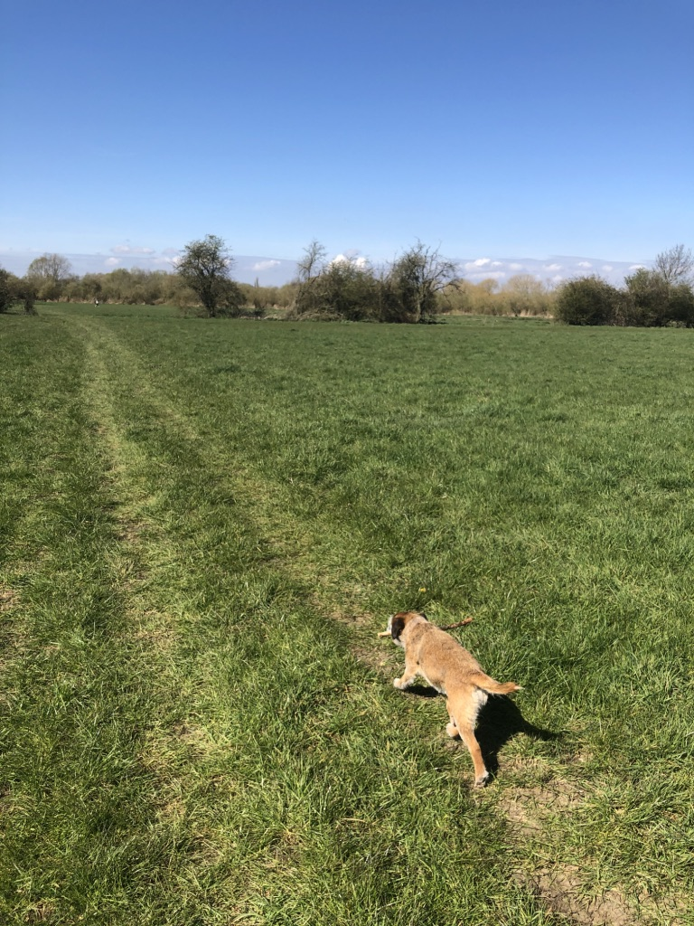
Monday
Roxy went for a walk…

Slide 3
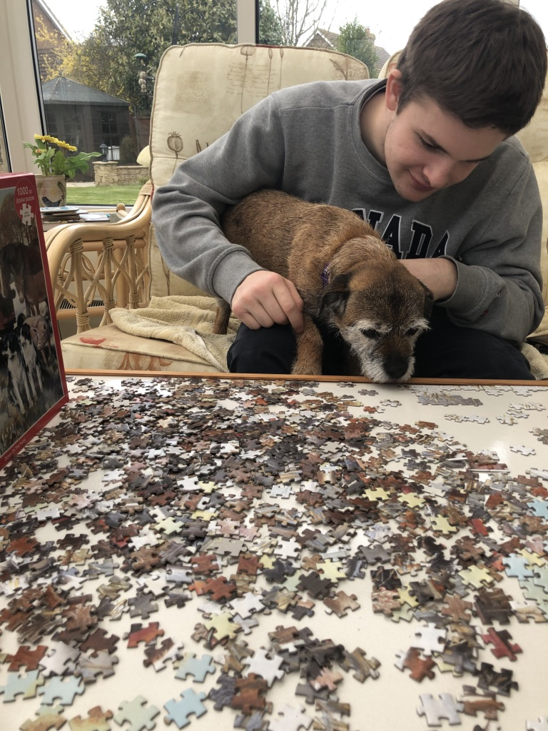
Tuesday
Roxy did a jigsaw…

Slide 4
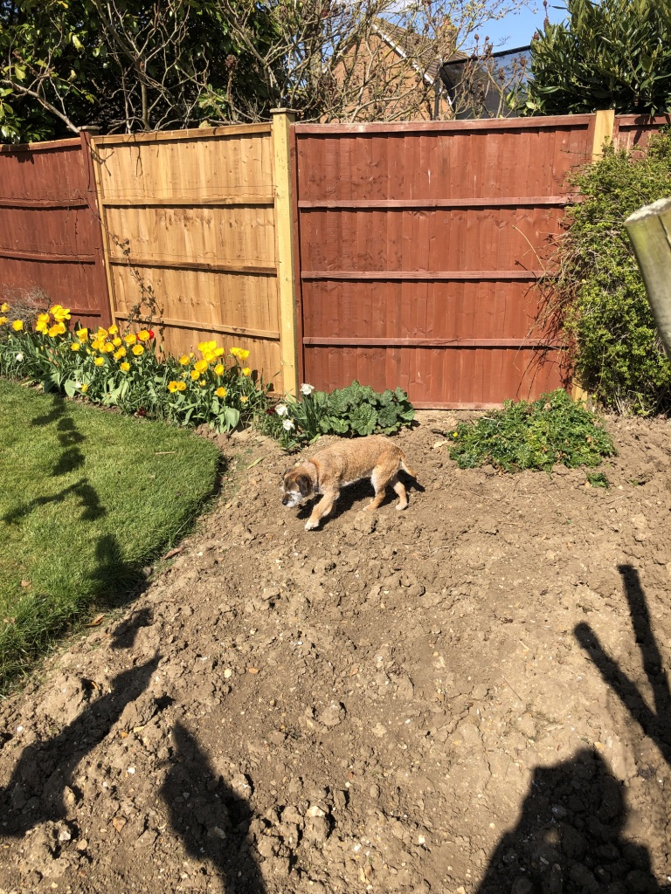
Wednesday
Roxy did some gardening…

Slide 5
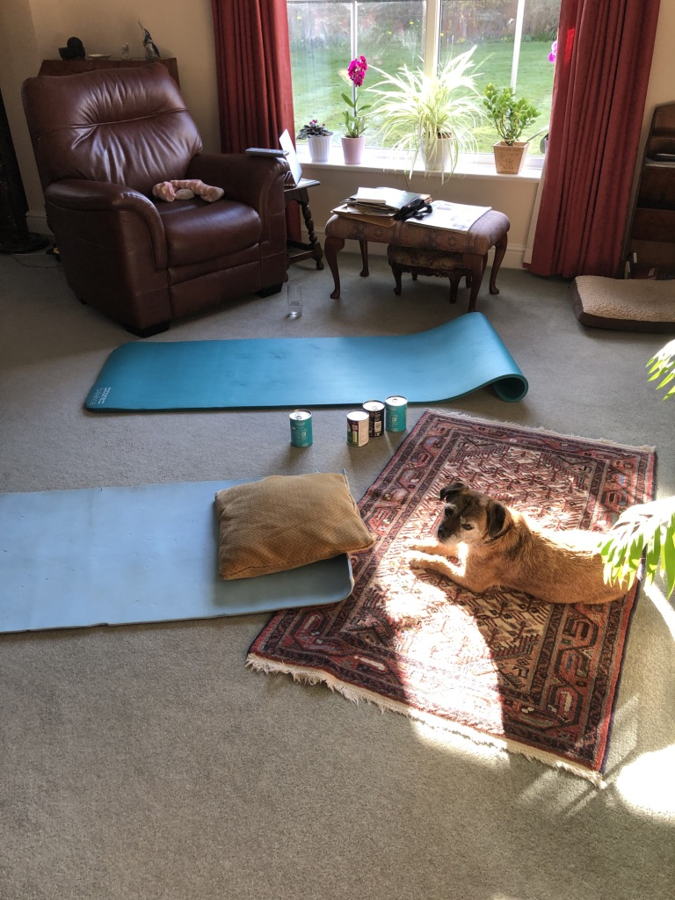
Thursday
Roxy did some yoga…

Slide 6
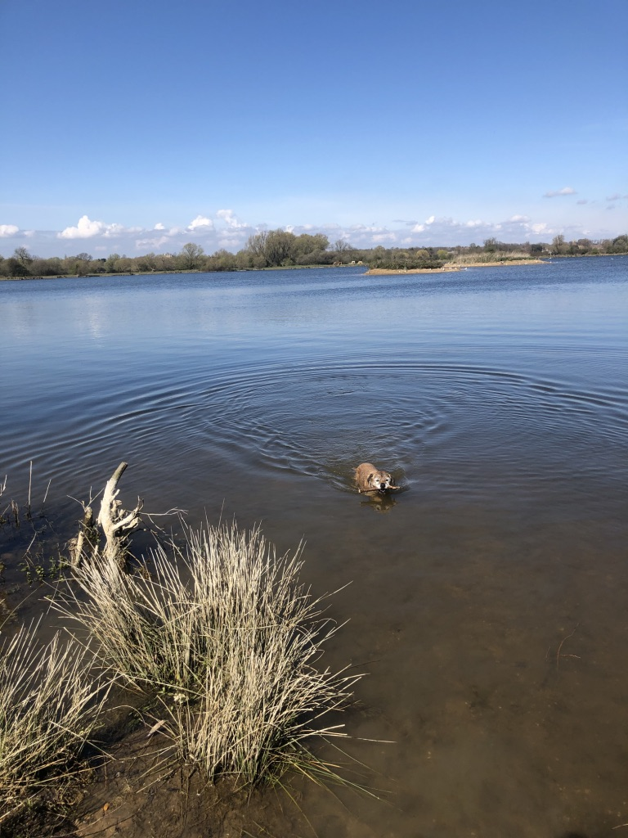
Friday
Roxy went for a swim…

Slide 7
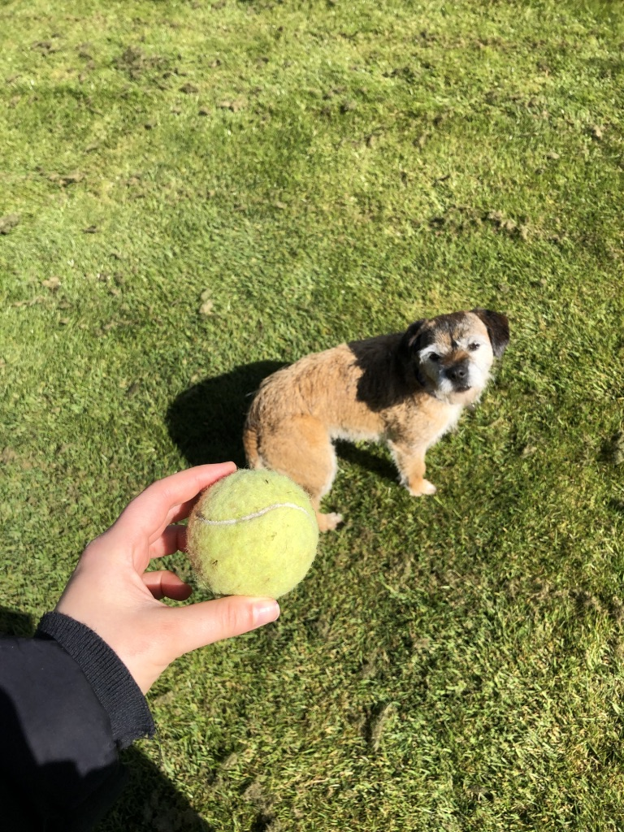
Saturday
Roxy played with a ball…

Slide 8
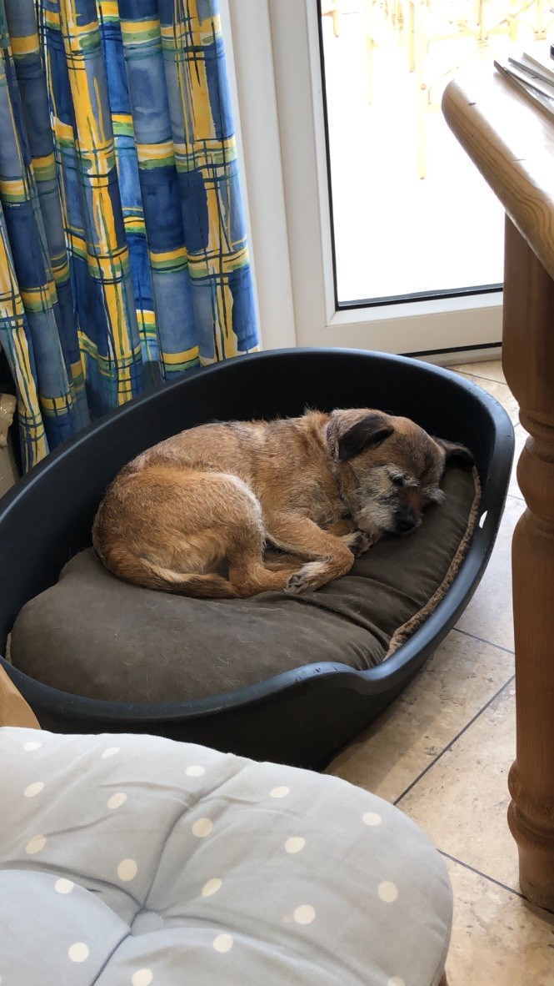
Sunday
Roxy slept!
She had a very busy week!

Slide 9
Can you remember what Roxy did each day?
Monday | Tuesday | Wednesday | Thursday | Friday | Saturday | Sunday
Roxy went for a walk.
Roxy did a jigsaw.
Roxy did some gardening.
Roxy did some yoga.
Roxy went for a swim.
Roxy played with a ball.
Roxy slept!

Slide 10
Now it’s your turn! Can you do the same for your pet? Or if you don’t have a pet, you can make one up! How about a pet monkey or a pet lion?! Be creative! I can’t wait to see what you do!

